Slide 1
Undirected Graphs
Lecture 10
Discrete Mathematical Structures

Slide 2
At the Last Class …
Part I: Rooted Trees
  Basic properties of rooted tree
  Labeled tree and its representation
  Tree searching
Part II: Undirected Trees
  Undirected graph: as a symmetric closure
  Basic properties of undirected tree
  Minimal spanning tree and its algorithm

Slide 3
Undirected Graphs
Part I: Graph as a Model
  Paths and circuits in a graph
  Subgraph and quotient graph
  Graph as a model for problem solving
Part II: Traversal in a Graph
  Euler paths and circuits
  Hamiltonian paths and circuits

Slide 4
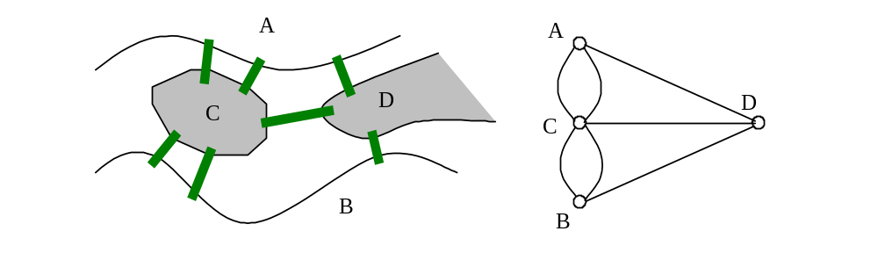
Seven Bridges at Königsberg
Abstraction
  Vertices representing objects - areas
  Edges representing the relationship between objects – connected by a bridge

Slide 5
Graph and Diagram
Graph G is a triple: G =〈V_{G}, E_{G}, ϕ〉
  V_{G} and E_{G} are sets，satisfying V_{G}⋂E_{G}=φ, ϕ:E_{G}→{{v_{i}, v_{j}}| v_{i}, v_{j}∈V_{G}} Note: {v_{i}, v_{j}}={v_{j}, v_{i}}
  A graph can be represented conveniently by some diagram: : each element of V_{G} as a dot, the vertex, and each element of E_{G} as a line segment, the edge, between two vertices.
  So, V_{G} is called the set of vertices, and E_{G}, the set of edges.
Note the differences between Geometric diagrams and Topological diagrams.
A definition of a graph does not depend on the diagram.

Slide 6
Relations in Graph
Relation defined from edge set to the Cartesian product of vertex set
  Incidence
Relation defined on the set of vertec
  Adjacency
Considering the relations above, a graph can be represented by matrix.

Slide 7
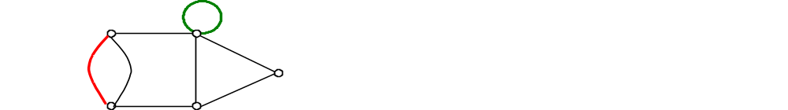
Simple Graph
Multiple edges and ring
  If ϕ is not a injection, that is, exist e_{i}, e_{j}∈E_{G}, e_{i}≠e_{j}, but ϕ(e_{i})=ϕ(e_{j}), then e_{i}, e_{j}是are called multiple edges.。
  For any e_{i}∈E_{G}, if ϕ(e_{i})={v_{i}, v_{i}}={v_{i}}, then e_{i} is called a ring.
Simple graph
  A graph without ring and multiple
  edges is called a simple graph.
(In a simple graph, an edge can be denoted as uv∈E .

Slide 8
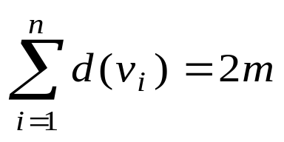
Degree of Vertex
Degree of vertex
  d_{G}(v) = number of edge incident to v
  d_{G}(v) must be a nonnegative integer.
  Δ(G) and δ(G)
Numerical characteristics of the degree of vertex
  Sum of degree of all vertices in a graph is even.
  m is the number of edges in the graph.
The number of vertices with odd degree must be even.

Slide 9
Subgraph
Let G=<V,E>, G’=<V’,E’>, if V’⊆V, E’⊆E, then G’is called a subgraph of G.
If V’⊂V, or E’⊂E, then G’ is a proper subgraph.
If V’=V, then G’ is a spanning subgraph.

Slide 10
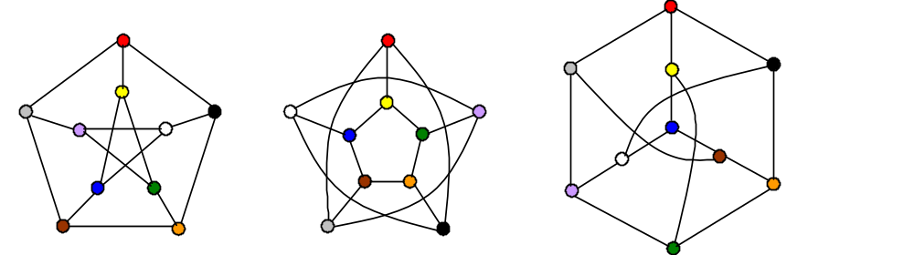
Isomorphic Graphs
The following three graphs are isomorphic (Petersen Graph)
  The correspondences under the isomorphism are denoted by colors:

Slide 11
Complete Graph
A graph is a complete graph if and only if any two of its vertices are adjacent.
  In the sense of isomorphism, for a given n, there is exactly one complete graph, denoted as K_{n}, where n is the number of vertices in the graph.
  In K_{n}, for any vertex v, d(v)=n-1.
  The number of edges in K_{n} is exactly n(n-1)/2.
  If G is a simple graph, then the number of its edges m≤n(n-1)/2

Slide 12
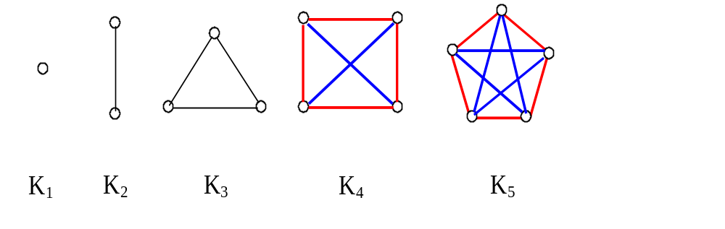
Complete Graph K_{n}(n=1,2,3,4,5)
A graph G and its complement graph have the same set of vertex, and their edges set constitute a partition of the edge set of the complete graph with the same vertex set.

Slide 13
Regular Graph
Two typical regular graph:
Note: in the graph on the left, each vertex is a binary number with the same number of bits.
000
001
010
011
110
111
100
101

Slide 14
Problem of “Crossing River”
Problem: A person(P), a wolf(W), a lamb(L) and a cabbage(C) will cross a river by a boat which can carry any two of them once. Wolf and lamb, or, lamb and cabbage, cannot stay together without the person present. Remember that only the person can run the boat.
Graph model: vertex: “Status of Leaving Bank”，uv∈E_{G} if and only if the transition from status u to v can be achieved by one allowed “cross” operation.
Starting status: “PWLC”, ending status: empty.
Solution: Finding a shortest path as possible from the starting status to the ending status.

Slide 15

Solution to the “Crossing River”
Note: There are 16 combinations of (P,W,L,C), but only 10 status are possible.
PWLC
PWC
PWL
PLC
PL
WC
W
C
L
φ
Success

Slide 16
Scheduling the Exams
Problem: Scheduling exams for different coursed. With no limitation on the space, we want to arrange all exams within a time span as short as possible. Any two course which is taken by one student cannot be scheduled in the same time slot.
Graph model: vertex: course; edge: uv∈E_{G} if and only if no student has taken both of courses u,v.
Solution: Coloring the vertices with different colors such that no adjacent vertices are with the same color. If the coloring can be achieved using as few as k colors, then the smallest number of the time slots needed for the exams is k.
  (The four-color problem is just a special case of this problem.)

Slide 17
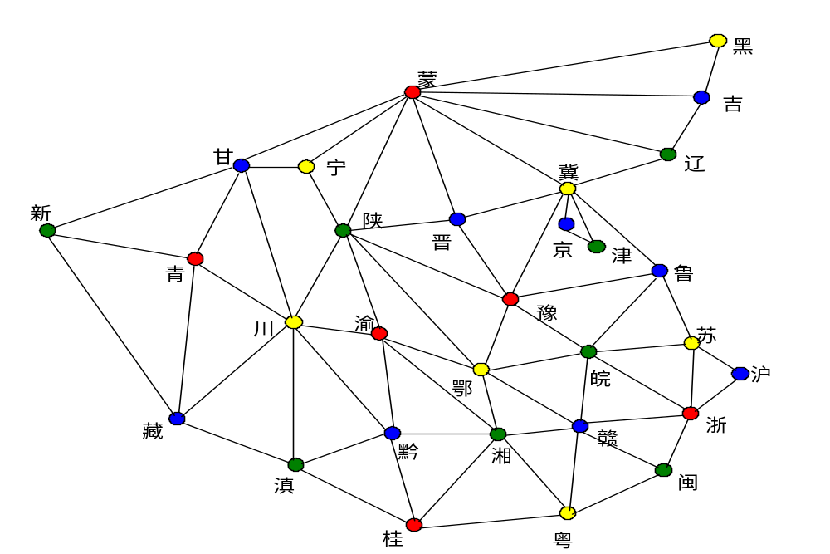
Coloring the Chinese Map
(Part)

Slide 18

Magic Pole
A “Magic Pole” consists of 4 cubic arranged as the right.
Each of the 6 face of a cubic is colored by a color in {Red, Yellow, Blue, Green}
Requirement: Each side of the “Magic Pole” show 4 different colors.

Slide 19
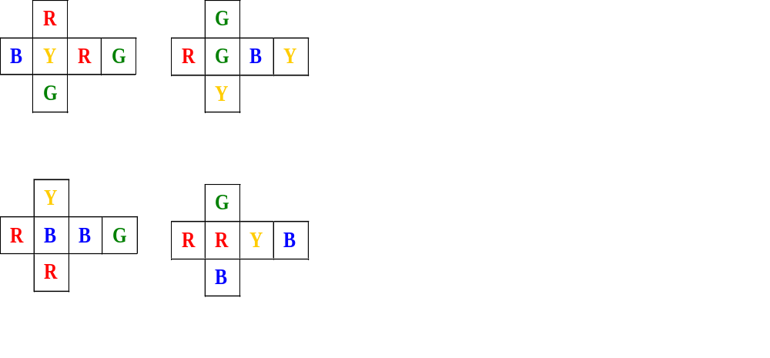
Problem Inputs
A special pattern of color is showed on the right, which defines a specific problem input for “Magic Pole”.
Problem: Does the solution exist? How to find it?
1
2
3
4

Slide 20




Possible Solution “Patterns”
（1）
（2）
（3）
（4）
（5）

Slide 21
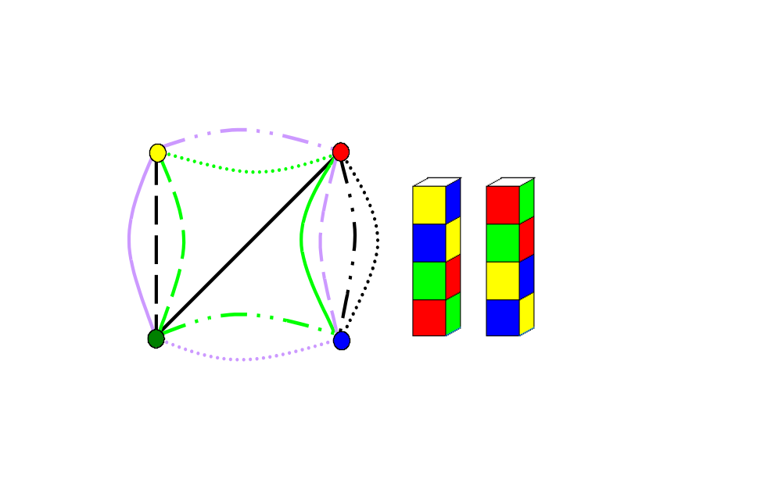
The Solution
Graph for solving “Magic Pole”: For any two vertices u,v(color), uv∈E_{G} 任if and only if u,v are opposite colors in a cubic.
Front and back of the solution showed on the right.
  Legend:
  1：
  2：
  3：
  4：

Slide 22
Path
Definition:
  (v₀,v_{k})-path in a graph G is a nonempty sequence: v₀e₁v₁e₂v₂…v_{k-1}e_{k}v_{k}, among which v_{i}∈V_{G}, e_{i}∈E_{G}, and the two endpoints of e_{i} are v_{i-1} and v_{i},(i=1,2,…,k)。
Simple path:
  v₀e₁v₁e₂v₂…v_{k-1}e_{k}v_{k}，satisfying ∀i,j, i≠j ⇒ v_{i}≠v_{j}

Slide 23
Circuit (Cycle)
Circuit is a path of which the starting point and the ending point are identical.
  v₀e₁v₁e₂v₂…v_{k-1}e_{k}v_{k}，satisfying v_{i}=v_{j}
Note: in a simple graph, the denotation of a path can be simplified as v₀v₁v₂…v_{k-1}v_{k},
Examples:
  Path: uavfyfvgyhwbv
  Path: wcxdyhwbvgy
  Simple path: xcwhyeuav
  Circuit: ueyhwbvau
u
e
a
f
y
v
g
d
h
b
c
x
w

Slide 24
Existence of Simple Path
If there is a (u,v)-path(u≠v) in graph G，then there must be a simple (u,v)-path
  Proof:
  Let W= v₀e₁v₁…v_{k-1}e_{k}v_{k}, is a (u,v)-path, where v₀=u, v_{k}=v。
  If ∀i,j, i≠j ⇒ v_{i}≠v_{j}, then W itself is a simple path.
  Otherwise, exist i,j(0≤i<j≤k), such that: v_{i}=v_{j}
  That is W=v₀e₁v₁e₂v₂…v_{i-1}e_{i}v_{i}…v_{j-1}e_{j}v_{j}e_{j+1}…v_{k-1}e_{k}v_{k},
  So, W‘= v₀e₁v₁e₂v₂…v_{i-1}e_{i}v_{i}e_{j+1}…v_{k-1}e_{k}v_{k} is still a (u,v)-path，but the number of pair of identical vertices in W’ decreases
  Note: W is a finite sequence, repeat the above procedure, we can get a simple (u,v)-path.
  If there are n vertices in G, the largest length of a simple path in G is n-1.

Slide 25
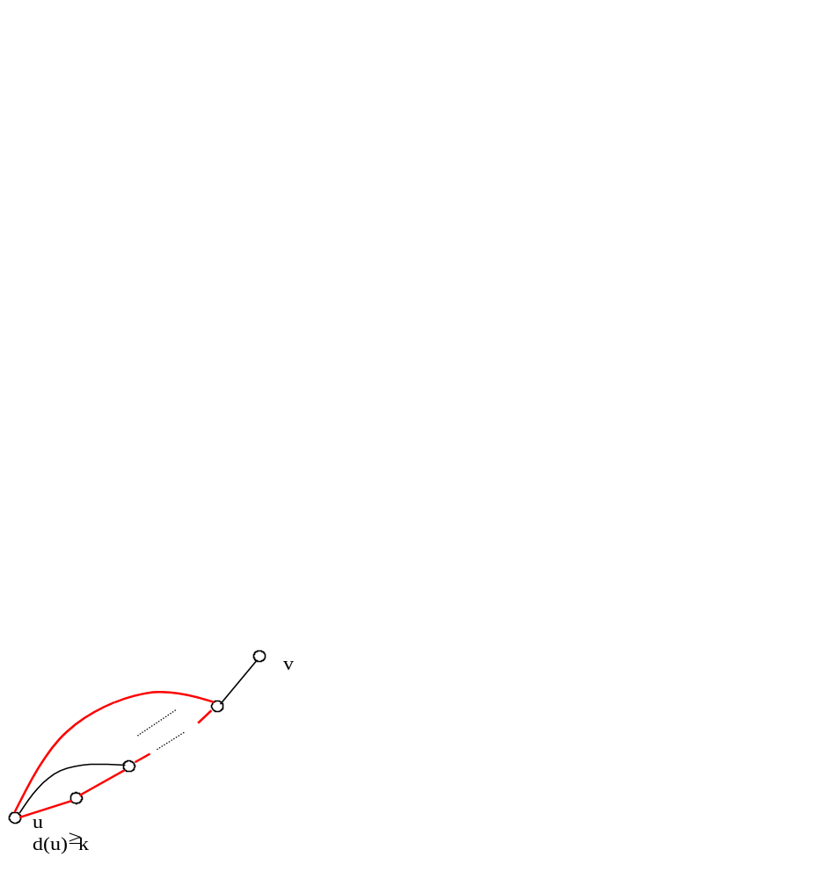
Least Vertex Degree and Circuit
Let G be a simple graph if d_{G}=k (k>1),
then there must be a simple circuit with
the length at least k+1 in G.
  Proof:
  Let P is any path in G, its ending points are u,v. If both u,v are not adjacent to any points outside P, then P is called a maximal path.
  Note: with any graph with edges, we can always find a maximal path beginning from any edge.
  Since d_{G}>1, there must be a maximal path (v₀, v₁, v₂,…,v_{m-1}, v_{m}), then v₀ is adjacent to at least k different vertices on the path. So, among the k-1 vertices, the farthest from v₀最with a subscript not less that k. Let it be v_{t}, then (v₀, v₁,…, v_{t}, v₀) is a simple circuit with the length at least k+1.

Slide 26
Reachability
Definition: R_{c}⊆V_{G}×V_{G}, ∀u,v∈V_{G}, <u,v>∈R_{c} if and only if there is a (u,v)-path in G.
We assume there is a path of length 0 from v to v for any vertex v.
Obviously, R_{c} is an equivalence.
In fact R_{c} is the transitive closure of the adjacence relation, R_{a}, on V_{G}.

Slide 27
Connected Graph and Components
Reachability relation is a equivalence relation, the equivalence is a component of G.
If there is only one component in G, then G is a connected Graph.
Graph G is connected if and only if ∀u,v∈V_{G}, there is a uv-path in G.

Slide 28
Connectivity of Complement Graph
Let G be a simple graph, then G or G‘, the complement graph of G, is a connected graph.
  Proof:
  Assuming G is disconnected, for any u,v∈G' :
  if uv∉E_{G} , u and v are adjacent in G‘;
  if uv∈E_{G} , since G is disconnected, there must be some vertex w, w is not in the component which u,v belong to. So uw∉E_{G}, vw∉E_{G}, so, uw∈E_{G'}, vw∈E_{G'}, that is, (u,w,v) is a uv-path in G‘.
  G‘ is connected.

Slide 29
Euler Path and Euler Circuit
An Euler path in G is a path which passes each edge in G exactly once.
An Euler circuit in G is a circuit which passes each edge in G exactly once.
An Euler graph is a graph which contains a Euler circuit.
A Semi-Euler graph is a graph which contains a Euler path, but not a Euler circuit.

Slide 30
Determination of Euler Graph
Three equivalent statements for a nontrivial connected graph G:
  (1) G is an Euler graph.
  (2) For any vertex v in G, d(v) is even.
  (3) All the edges in G constitute one or more simple circuits without common edges between them.
  Proof:
  (1)⇒(2): Assuming that W is an Euler circuit in G, then ∀v∈V_{G}, d(v) is 2 times of the number by which v appears on W.

Slide 31
Determination of Euler Graph(cont.)
(2)⇒(3): induction on the number of edges in G, m
  When m=1, G is a ring, the conclusion is true. Assuming that the conclusion is true for any m≤k(k≥1)
  If m=k+1, since δ_{G}>1, G contains simple circuit. Let C be a simple circuit, and G'=G-E_{C}, let G‘ contain s components, then in each component, every vertex has a even degree, and the number of edges is not larger than k. The inductive hypothesis applies, which leads to the conclusion.
(3)⇒(1). induction on the number of simple circuit in G
  Obvious for d=1. Assuming that the conclusion holds for d≤k(k≥1).
  If d=k+1, with some ordering on all simple circuit, let G‘=G-E(C_{k+1})，For all component of G’, the inductive hypothesis applies, that is, each component is an Euler circuit. It is easy to constitue an Euler circuit for G using all the circuits in components.

Slide 32
Fleury Algorithm
Basic idea: when we really draw an Euler circuit, all passed edges cannot be used again. So, at any moment in drawing, with all passed edges deleted, the remain edges must be in one component. 。
Algorithm
  Input: an Euler graph G
  Output: a path P = v₀e₁v₁e₂,…,e_{i}v_{i}e_{i+1},…,e_{m}v_{m}, which includes each edge in E_{G} exactly once.
  Procedure
  1. Take v₀∈V_{G} randomly, let P₀=v₀;
  2. Assuming P_{i}=v₀e₁v₁e₂,…,e_{i}v_{i}, select e_{i+1} from E_{G}-{e₁,e₂,…,e_{i}} according to the following criteria:
    (a) e_{i+1} is incident to v_{i};
    (b) If possible, e_{i+1} is not a cut edge in G-{e₁,e₂,…,e_{i}}
  3. Repeat step 2, until no firther step can be executed legally.

Slide 33
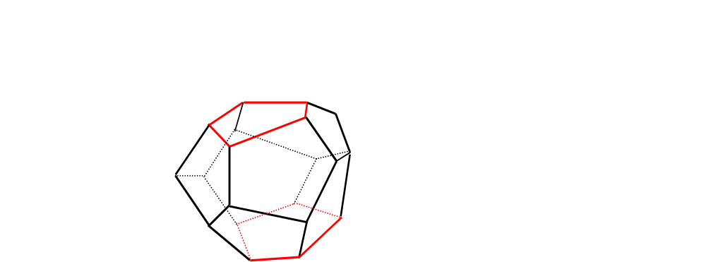
All Around the World
In 1859, an Irish mathematician, Hamilton, introduced the game called “All around the world”
Each angular point of the
dodecahedron represents
a city all around the world.
The player is required to
start from a city, pass every
city exactly once, along the
edges, and return to the starting city finally.

Slide 34

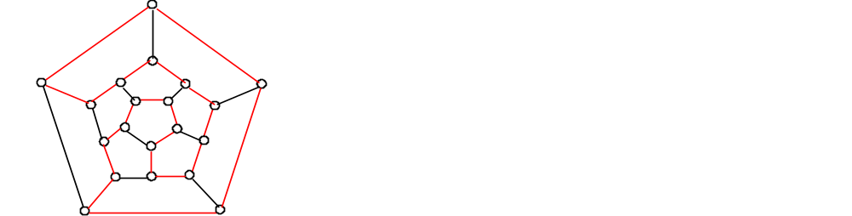
Hamiltonian Path and Circuit
In a graph G, a circuit is called a Hamiltonian circuit if and only if it contains all the vertices in G exactly once. If G contains a Hamiltonian circuit, G itself is called a Hamiltonian graph.
A Hamiltonian path is a
simple path which contains
all vertices exactly once.
A semi-Hamiltonian graph
contain a Hanmiltonian path,
but not a Hamiltionian circuit.

Slide 35
A Necessary Condition
Observation:
  Any Hamiltonian graph is in fact a simple circuit plus some linking some pairs of vertex on the circuit. 。
  Deleting k vertices from a simple circuits results in at most k components.
  Inserting edges between a pair of vertices not adjacent to each other will not increase the number of component.
Conclusion:
  Let G be a Hamiltionian graph, then for any nonempty subset V₁ of V_{G}, the number of components in G-V₁ is not larger than the number of vertices in V₁.

Slide 36
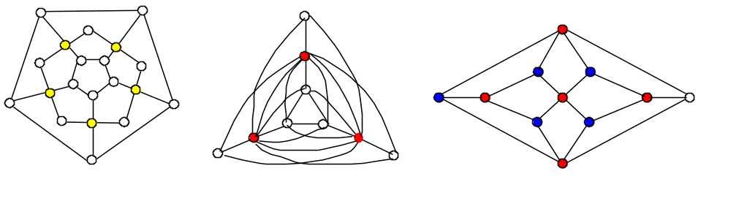
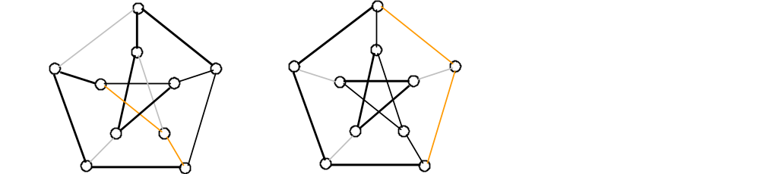
Examples
Necessary condition can only be used to determine that a graph is not a Hamiltonian graph.
  In fact, Petersen (right) is not
  Hamiltonian graph.

Slide 37
Degree of Vertices and Connectivity
A graph must be connected if the lower bound of the sum of any vertex pair is large enough.
G is a simple graph with no less than 2 vertices. G is connected if for any vertices u,v (not adjacent to each other):
d(u)+d(v)≥n-1 (n is |V_{G}|) (condition *)
  Proof:
  Assuming that G is disconnect, and G₁, G₂ are two of the components. For x∈V_{G1}, y∈V_{G2}, we have d(x)+d(y)≤(n₁-1)+(n₂-1)≤n-2 (n_{i}是is |G_{i}|), contradiction.

Slide 38
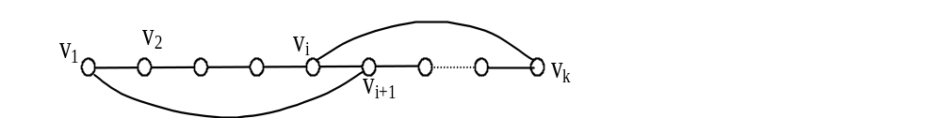

Transform a Maximal Path to Cycle
If condition (*) holds for graph G, and let Γ=v₁v₂…v_{k-1}v_{k} be a maximal path not containing all vertices in G(k<n), then all vertices on Γ are on a simple circuit.
  If v₁v_{k}∈E_{G}，conclusion holds.
  Otherwise let S={v_{i}|v₁v_{i+1}∈E_{G}}，T={v_{j}|v_{j}v_{k}∈E_{G}}；
  Note: |S|+|T|= d(v₁)+d(v_{k})≥n-1,
  v_{k}∉S⋃T, ∴|S⋃T|≤k-1<n-1, ∴|S⋂T|=|S|+|T|-|S⋃T|>0, that is, S⋂T is nonempty，let v_{i}∈S⋂T, then v_{i+1}v₁∈E_{G}，and v_{i}v_{k}∈E_{G}. So, C=v₁…v_{i}v_{k}v_{k-1}…v_{i+1}v₁是is a circuit containing all vertices on Γ.

Slide 39
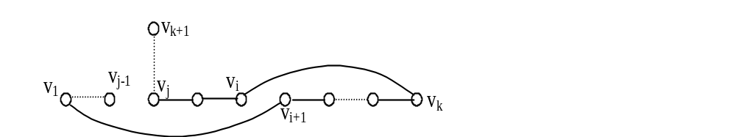
Sufficient Condition for Semi-H Graph
Condition * is a sufficient condition for semi-Hamiltionian graph.
If fact, if condition * holds for G, then the maximal path must be a Hamiltionian path.
  Assuming that Γ=v₁v₂…v_{k-1}v_{k} is a maximal path, but k<n, then it can be transformed to a simple circuit C. Let v_{k+1} is one of the vertices outside of C. Since G is connected, there must be a path from v_{k+1} to the vertices in C. Assuming that the shortest of such paths meets Γ at v_{j}(not v₁,v_{k}, obviously). Then Γ ‘= v_{k+1}…v_{j}…v_{i}v_{k} v_{k-1}…v_{i+1}v₁…v_{j-1} is a extension of Γ, contradiction.

Slide 40
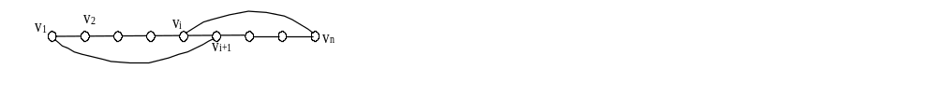
A Sufficient Condition for Hamiltonian Graph
G is a simple graph with not less than 3 vertices. If for any vertices u,v not adjacent in G:
d(u)+d(v)≥n (n is |V_{G}|)
Then G is a Hamiltonian graph.
Proof:
  Obviously G is a semi-Hamiltonian graph. Let Γ=v₁v₂…v_{n-1}v_{n} be a Hamiltonian path in G.
  If v₁v_{k}∈E_{G}, conclusion holds. Otherwise，let S={v_{i}|v₁v_{i+1}∈E_{G}}，T={v_{j}|v_{j}v_{k} ∈E_{G}}. Note: |S|+|T|= d(v₁)+d(v_{n})≥n,
  v_{n}∉S⋃T, ∴|S⋃T|≤k-1<n, ∴|S⋂T|=|S|+|T|-|S⋃T|>0, that is, S⋂T is nonempty, let v_{i}∈S⋂T, then v_{i+1}v₁∈E_{G}, v_{i}v_{n}∈E_{G}. So, C=v₁…v_{i}v_{n}v_{n-1}…v_{i+1}v₁ is a Hamiltonian circuit.

Slide 41
Gaps between Two Kinds of Conditions
Necessary conditions not satisfied
Determined case by case using
“common senses”
  For each vertex, exactly two of the
  incident edges are contained in the
  Hamiltonian circuit.
  No proper sub-circuit can be
  contained in a Hamiltonian circuit.
  Making use of symmetry
  ......
？
Sufficient conditions satisfied

Slide 42
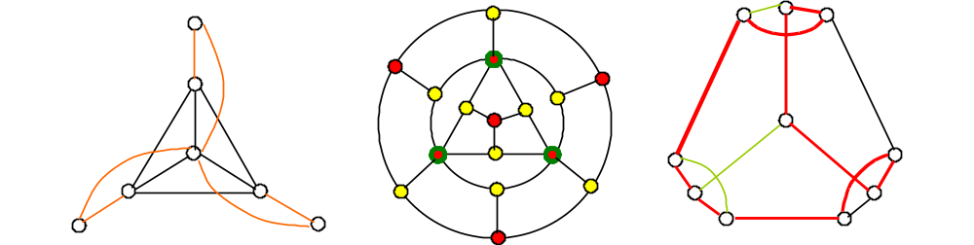
Examples
Only the graph on the right is Hamiltonian

Slide 43
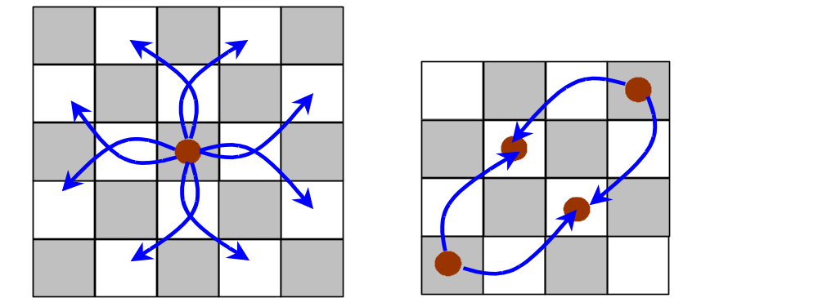
Hamiltonian Circuit on a Chess Board
On a minimized 4×4 or 5×5 chess board, Knight cannot traverse each square exactly once and return to the starting square.

Slide 44
Traveling Sales Person (TSP)
Problem: There are n cities with road of different distances between any two of them. A traveling sales person plan to traverse each city exactly once and return to the starting place. How should he choose the shortest traversal route?
Mathematical model:
  Construct a weighted graph G， with elements in V_{G}中 corresponding to cities, and those in E_{G}, to road between cities. The weights are the distances.
  The solution is a Hamiltonian circuit with the least weight.
  G, as a complete weighted graph, has n!/2 different Hamiltonian circuit. The problem is “which is the shortest?”
  (For your reference: 含there are about 1.21645×10¹⁷)/2 different candidate routes in a complete Hamiltonian graph with 20 vertices. If check mechanically, with the speed of 100,000/sec. it takes 20,000 years!)

Slide 45
TSP: an Approximate Algorithm
The procedure
  (1) Find a route using “Greedy approach” – may not best.
  (2) Improvement: If, in current route, exists W(v_{i},v_{j})+ W(v_{i+1},v_{j+1})< W(v_{i},v_{i+1})+ W(v_{j},v_{j+1}), then replace v_{i}v_{j} and v_{i+1}v_{j+1} with v_{i}v_{i+1} and v_{j}v_{j+1}
Taking a “better” route starting from a, length: 40
a
9
14
12
a
d
c
e
b
a
b
9
c
7
6
8
5
14
10
7
5
8
Improved route, length: 37
13
6
10
11
9
d
e
a
d
c
e
b
a
7
6
5
10

Slide 46
Home Assignments
To be checked
  pp.295-: 16-18, 27-29, 31-32
  pp.302-: 4, 6, 9, 12, 13-14, 18, 19-25
  pp.306-: 3, 6, 10, 14, 19-25
Self tests

